Slide 1


Storage Engine Enhancements
New in SQL Server

Slide 2

XML Compression

Slide 3


XML Data in SQL Server
Has been around a long time (since SQL 2005!).
Allows users to store unstructured data in a relational database model.
Widely used in Banking, Legal, and Healthcare for data archival.
XML data (i.e., documents) tend to be quite verbose, leading to large storage and memory requirements.
Data also tends to be stored for long periods of time (e.g. for archiving) requiring a lot of storage capacity.
Cost of storage can become a problem.
XML data is typically stored off-row and therefore cannot be compressed using row and page level compression

Slide 4

Introducing XML Compression in SQL Server 2022
New algorithm specifically designed to compress XML data (both in-row and off-row)
Intended to provide significant cost savings for customers who store large amounts of XML data in SQL Server
Also expected to improve performance of querying XML data
No code changes needed
Can lead to smaller indexes, reducing maintenance overhead
Compatible with Row and Page level compression (i.e., even more savings!)

Slide 5
Enable XML Compression
When creating or altering a table
When creating or altering an index
CREATE TABLE Production.ProductModel ( ProductModelId int, ModelName varchar(50), ModelDetails xml, ) WITH (XML_COMPRESSION = ON); --WITH --( -- XML_COMPRESSION = ON ON PARTITIONS (1,2), -- XML_COMPRESSION = OFF ON PARTITIONS (3) --);
CREATE CLUSTERED INDEX CX_Production_ProductModel
ON Production.ProductModel (ProductModelId)
WITH (XML_COMPRESSION = ON);
CREATE NONCLUSTERED INDEX IX_ModelName
ON Production.ProductModel (ModelName)
WITH (XML_COMPRESSION = ON);
ALTER INDEX IX_ModelName
ON Production.ProductModel (ModelName)
REBUILD
WITH (XML_COMPRESSION = ON);
ALTER TABLE Production.ProductModel REBUILD PARTITION = ALL WITH (XML_COMPRESSION = ON);

Slide 6
Estimate Storage Savings
sp_estimate_data_compression_savings
EXEC sys.sp_estimate_data_compression_savings 'Production', -- schema 'ProductModel', -- object NULL, -- index id NULL, -- partition # 'PAGE', -- @data_compression 1; -- @xml_compression
@data_compression
PAGE
ROW
COLUMNSTORE
COLUMNSTORE_ARCHIVE
@xml_compression
1 = calculate xml compression
0 = do not calculate
NULL = Default.
sp_estimate_data_compression_savings (Transact-SQL) - SQL Server | Microsoft Learn

Slide 7

Demo

Slide 8

Hands-free TempDB

Slide 9
Basics of Tempdb
Basically, just a database
Workload is different
Critical to performance
Structure is the same as other user databases
Re-created every time the server is restarted
Used for temporary (non-durable) storage
Objects and data frequently being created and destroyed
Transactions minimally logged
Data that can’t fit in memory stored here – access needs to be fast
Often used to store intermediate query results – direct impact to query performance
Very high concurrency

Slide 10
What is stored in tempdb?
Temp Tables
Row Versions
Triggers
Statistics updates
DBCC CHECKDB
Online Index Operations
Hash Worktables
Table Variables
Table-Valued Functions
Sorts
Spools
Cursors

Slide 11


Problem 1: Object Allocation Contention
tempdb.mdf
tempdb2.ndf
Header
0 | Header
1 | PFS
2 | GAM
3 | SGAM
…
8088 | PFS
…
511232 | GAM
511233 | SGAM
0
1
2
3
…
8088
…
511232
511233
PFS
Page Address is
DBID:FileID:Page#
2:1:1
GAM
SGAM
Page Free Space
8,087 Pages
Global Allocation Map
Uniform Extents
63,904 Extents
PFS
Shared Global Allocation Map
Mixed Extents
63,904 Extents
High number of latch waits with only one data file
Reduced latch waits as a result of adding more data files, effectively increasing the number of allocation pages
GAM
SGAM

Slide 12
Problem 2: Metadata Contention
Node 1
Node 2
Node 3
CREATE #T1
CREATE #T2
CREATE #T3
CREATE #T4
CREATE #T5
CREATE #T6
CREATE #T7
CREATE #T8
CREATE #T9
CREATE #T10
CREATE #T11
CREATE #T12
INSERT
INSERT
INSERT
INSERT
INSERT
INSERT
INSERT
INSERT
INSERT
INSERT
INSERT
INSERT
sysobjvalues

Slide 13
Summary of Types of Contention
Object Allocation Contention
Contention for metadata pages used to manage space allocation in a data file
Metadata Contention
Contention for pages that belong to system objects used to track table metadata
Look for PAGELATCH waits on pages that belong to system objects
Temp Table Cache Contention
Contention for memory objects associated with the Temp Table Cache
Look for either CMEMTHREAD waits or SOS_CACHESTORE spinlock waits (both can be due to other causes)
Look for PAGELATCH waits on PFS and GAM pages

Slide 14
What was done (historically)?
SQL Server 2000 (SP4)
KB 328551
SQL Server 2005
Trace flag 1118
Multiple files
New items added to tempdb
Temp table caching
In-memory OLTP
Server 2016
TF 1117 & 1118
Multiple files
SQL Server 2017
tempdb Improvements
PFS round-robin
Asynch metadata cleanup
Optimistic latching 2
SQL Server 2014
Recommended settings now default
Optimistic latching for metadata
Row-versioning
Table Variables
Configuration added to setup

Slide 15
What are your options?
Configuration
Ensure that you have multiple equally sized files
Enable TF 1117 and 1118 if you are on SQL Server 2014 or earlier
Code Changes
Do not alter temp tables after they have been created
Start with the lesser of 1 per core or 8 and increase as needed
Move index creation statements to the new inline syntax
Avoid using temp tables inside ad-hoc batches
Version
Ensure you are on the latest service pack and CU to take advantage of all improvements
If TempDB contention is still persistent and severe, consider upgrading to SQL Server 2019 and higher.
Do not truncate temp tables

Slide 16
Beginning of the End
Accelerated Database Recovery
sys.dm_db_page_info
sys.fn_PageResCracker
Leverages a new feature called Persistent Version Store
New Page Cracker allows you to quickly and easily diagnose contention
Default changes
Memory-optimized metadata tables
Opt-In
Temp table cache improvements
Concurrent PFS updates
tempdb-related enhancements in SQL Server 2019

Slide 17
Closing the Loop: TempDB on SQL Server 2022
System page latch concurrency enhancements
On by default
Concurrent updates to the GAM and SGAM
Shared latch rather than using the update latch
Nearly all tempdb contention
Parallel modification to GAM/SGAM pages
Testing
Do we still need multiple data files for tempdb?
Only time and testing will tell.
Testing show that over 99.99% of all contention is removed.
Contention should now be rare
For now, still recommended.

Slide 18
Demo

Slide 19

Parallel Buffer Scan
“It just runs faster!”
Notes:
“It just runs faster”
Meaning: This is a benefit that many customers will witness simply by upgrading to SQL Server 2022 as the capability is enabled by default.

Slide 20

What is the problem?
MS Case | Problem Description
RFC6592713 | Creating a new database takes a long time on systems with large memory (10m on 2TB).
RFC6633582 | Slow log restore on large memory machines (10s on 1.5TB).
RFC12263913 | AG database failover/startup takes a long time (2TB memory).
RFC12877984 | Drop data files taking a long time on large memory server (1TB).
RFC12306166 | Database took around 6 minutes to complete UNDO on a new secondary replicate after failover.
RFC13125140 | DBCC Checktable against empty table takes more than 60 seconds with 2TB RAM.

Slide 21
What is the cause?
In SQL Server 2019 and below…
Routine Name | Examples of SQL Operations
FlushCache | Checkpoints, Redo, file/TDE operations Backup/Restore, AlwaysOn operations
MarkBuffersCopyOnWrite | CheckDB, Snapshot, Restore with Standby
RemoveBuffersFromDB/File | DB shutdown/restart, CheckDB, File drop/shrink, Restore
Various SQL Operations trigger internal routines that lead to a full serial scan of the Buffer Pool
Notes:
Database startup/shutdown
Creating a new database
File drop operations
AlwaysOn failover events
DBCC CHECKDB and CHECKTABLE
Log Restore operations
Checkpoint

Slide 22
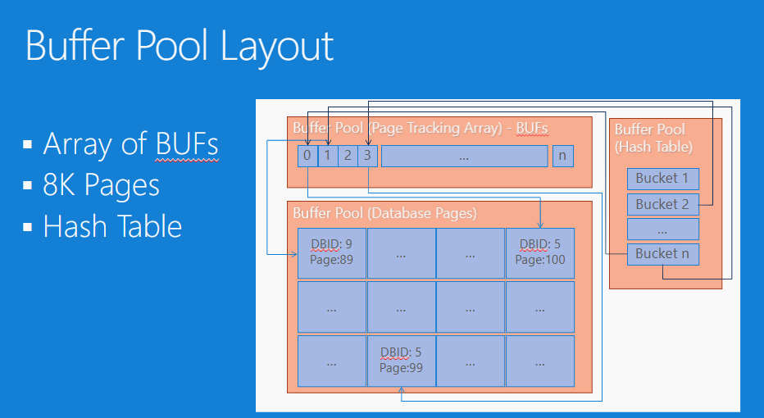
The Buffer Descriptor Array
Notes:
BufferPool scan involves iterating through the entire buffer descriptor array in a serialized fashion.
And just to give you a sense of why this could lead to delays…
A warm buffer pool (meaning SQL Server has not just been restarted) with the size of 2TB will have a whopping 250 million buffers to iterate! Hence, why a BP scan can take a long time.
It doesn’t matter if your database is small or large, it’s a function of the size of your Buffer Pool (not your database).
So, what that means is, even if your database is empty but you have a large BP, you can still experience long executions on operations that lead to a Buffer Pool scan.

Slide 23
Do I have this problem?
T3504 (SQL 2012 and above)
Reports FlushCache messages in the Errorlog
EXAMPLE:
FlushCache: cleaned up 0 bufs with 0 writes in 1 ms (avoided 0 new dirty bufs) for db 8:0
average throughput: 0.00 MB/sec, I/O saturation: 0, context switches 0
last target outstanding: 2, avgWriteLatency 858993
New Buffer Pool scan messages in Errorlog
Available in SQL 2016 SP3, SQL 2017 CU23, SQL 2019 CU9
EXAMPLE:
Buffer Pool scan took 14 seconds: database ID 7, command 'BACKUP DATABASE', operation 'FlushCache', scanned buffers 115, total iterated buffers 204640239, wait time 0 ms. See 'https://go.microsoft.com/fwlink/?linkid=2132602' for more information.
Extended Events:
EXAMPLE:
buffer_pool_scan_complete (SQL 2016 SP3, SQL 2017 CU23, SQL 2019 CU9)
name | database_id | elapsed_time_ms | command | operation | scanned_buffers | total_iterated_buffer
buffer_pool_scan_complete | 7 | 1308 | Backup Database | FlushCache | 243 | 19932814
Notes:
“with 0 writes in 1 ms” = means there was no I/O and the time was spent only with the routine (FlushCache) scanning the buffers
New BP scan errorlog message: Triggered when scan takes more than 10 seconds
Buffer_pool_scan_complete: Triggered when scan takes more than 1 second.

Slide 24
How do we fix the problem? (Part 1)
Solve the Checkpoint problem (Internal Operation)
Indirect Checkpoint
Introduced in SQL 2012 (opt-in)
Uses Dirty Page Manager (DPM) to track dirty pages (goodbye FlushCache!)
Uses a partitioned list (more efficient)
Enabled by default in SQL 2016
https://learn.microsoft.com/en-us/archive/blogs/bobsql/sql-2016-it-just-runs-faster-indirect-checkpoint-default

Slide 25
How do we fix the problem? (Part 2)
Introducing: Buffer Pool Parallel Scan
Enabled by default in SQL Server 2022
Uses multiple CPU cores when scanning 64GB or more
1 thread per 8M buffers (64GB). Max 32 threads or half of CPUs (whichever is less)
Dynamically throttle number of threads if there are concurrent scans
Customers with large systems, running mission critical OLTP and data warehouse will see the most benefit.
Significantly improve performance of various SQL operations

Slide 26
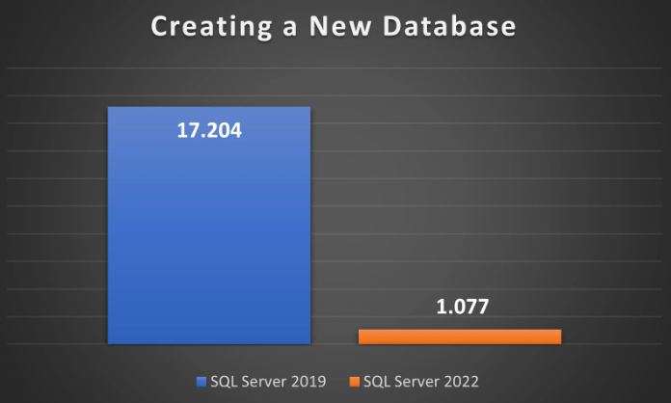
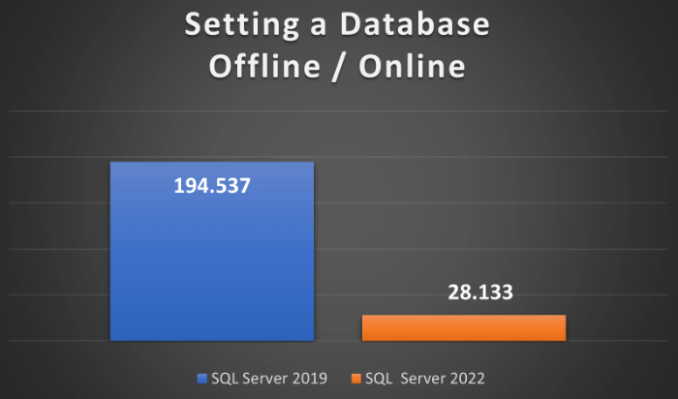
How much improvement is expected?
Performance testing on an HPE ProLiant DL580 Server
RAM: 2TB
SQL Memory: 1.84TB
Notes:
CREATING A NEW DATABASE:
Creating a new database on a SQL Server 2019 machine took 17.204 seconds whereas the same database creation script took just over 1 second on SQL Server 2022.
SETTING DATABASE OFFLINE/ONLINE (TO SIMULATE DATABASE FAILOVER):
On SQL Server 2019 this event took over 3 minutes and 15 seconds. On SQL Server 2022, the same event took just over 28 seconds.

Slide 27
Other Performance Test Results
H/W Configuration:
HP DL580
RAM: 2TB
BP: 1TB (~140M BUFs)
Small DB: 1MB
Large DB: 1TB
Metric: Elapsed time in secs
Scenario | Serial | Parallel (2) | Parallel (16) | Remark
FlushCache | 7 | 3.3 | 0.5 | 15x faster
ShutdownDB (Small) | 6.2 | 3.3 | 0.5
ShutdownDB (Large) | 180 | 120 | 32 | 6x faster
DBCC Check (Small) | 30 | 15 | 2 | 15x faster 4 scans
DBCC Check (Large) | 55 | 30 | 5.4 | 10x faster 4 scans
CreateDB | 7 | 3.4 | 0.5 | Run FlushCache
BackupDB | 7 | 3.4 | 0.5 | Run FlushCache
RestoreLog | 17 | 7.8 | 1.1 | Run 2 FlushCache
DropCleanBuffers | 100 | 51 | 29 | 4x faster
Notes:
Notes
DBCC Check runs 4 scans: FlushCache, MarkBuffersCopyOnWrite (2x), ShutdownDB
For simple operations, the gain is about 15 times with 16 parallel tasks
For complex operations (RemoveBuffersFromDB, MarkBuffersCopyOnWrite, DropCleanBuffers), the gain is 4 ~ 10 times

Slide 28
Configuration and Logging (Trace Flags)
Trace Flag | Description
892 | Disable Buffer Pool parallel scan feature
893 | Enable Buffer Pool scan diagnostic trace (errorlog).
894 | Enable Buffer Pool scan verbose trace (errorlog).
889 | Always report long buffer pool scan complete messages (error 898) in the errorlog. This allows to collect the buffer pool scan diagnostics regardless of duration threshold.
890 | Turn off long buffer pool scan complete messages (error 898) in the errorlog.
895 | Customize the maximum number of parallel tasks for Buffer Pool parallel scan. When the flag is on, use the limit from the XDB config or the registry.
897 | Use the maximum number of parallel tasks for Buffer Pool parallel scan. This enforces Buffer Pool scan to always use the maximum number of parallel tasks. This can be useful for testing purpose as well to simulate parallel scan behavior even without a large number of buffers.

Slide 29
Configuration and Logging (XE)
Event Name | Channel
buffer_pool_scan_start | Debug
buffer_pool_scan_complete | Analytic
buffer_pool_scan_task_start | Debug
buffer_pool_scan_task_complete | Debug
buffer_pool_scan_task_error | Debug
buffer_pool_scan_stats | Analytic
buffer_pool_flush_cache_start | Debug
buffer_pool_flush_cache | Analytic
buffer_pool_flush_io_throttle | Debug
buffer_pool_flush_io_throttle_status | Debug
Notes:
1. Could TDE benefit from this feature? (Murali)

Slide 30
Demo

